Slide 1

Malpractice Analyser (Using Facial Expressions)
Guide –Prof. Muneeswaran
Team Members
Ananya Singh (19BCE10177)
Shreyash Mall(19BCE10054)

Slide 2

Introduction
A Facial expression is the visible manifestation of the affective state, cognitive activity, intention, personality and psychopathology of a person and plays a communicative role in interpersonal relations. Automatic recognition of facial expressions can be an important component of natural human-machine interfaces; it may also be used in behavioral science and in clinical practice. An automatic Facial Expression Recognition system needs to perform detection and location of faces in a cluttered scene, facial feature extraction, and facial expression classification.

Slide 3
Proposed work and Methodology
Neural Network Development
&
Machine Learning
Malpractice Analyser Using Facial
Expression
Development of Facial Expression Recognition System

Slide 4
Real time usage
During online Interview
Online Examinations
Analysing Human Behavioural Changes

Slide 5
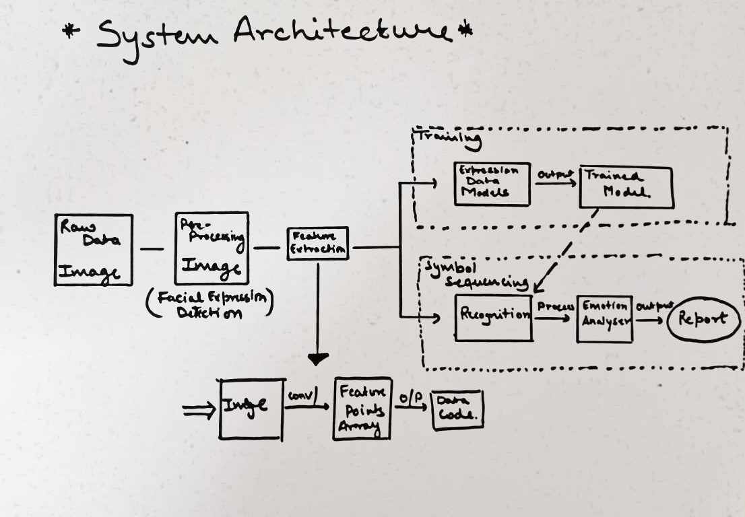
Overall System Architecture

Slide 6
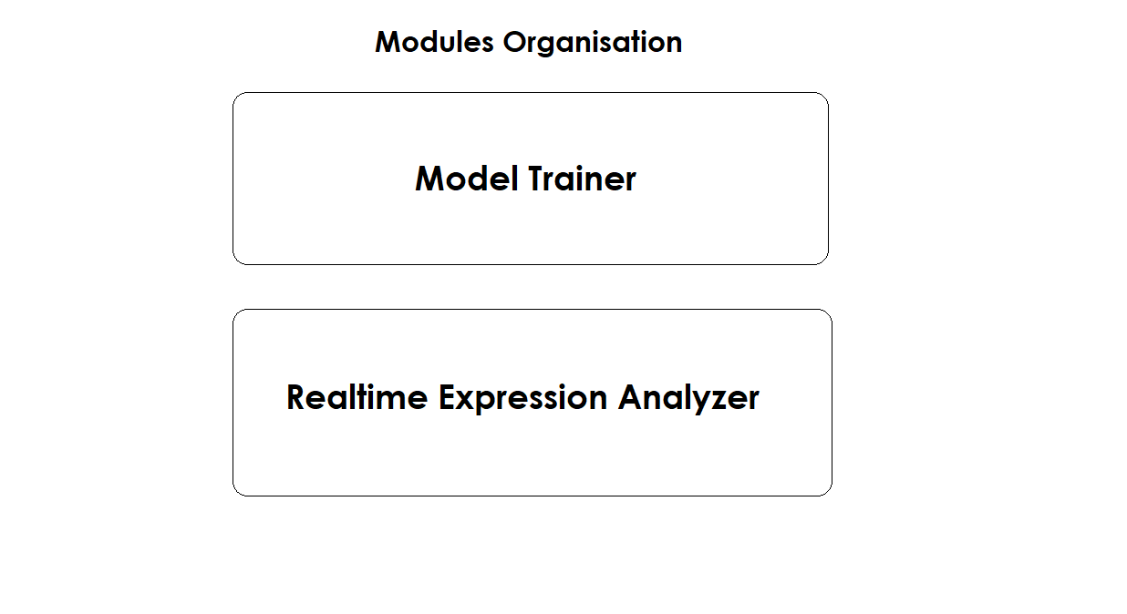
Module Organisation

Slide 7
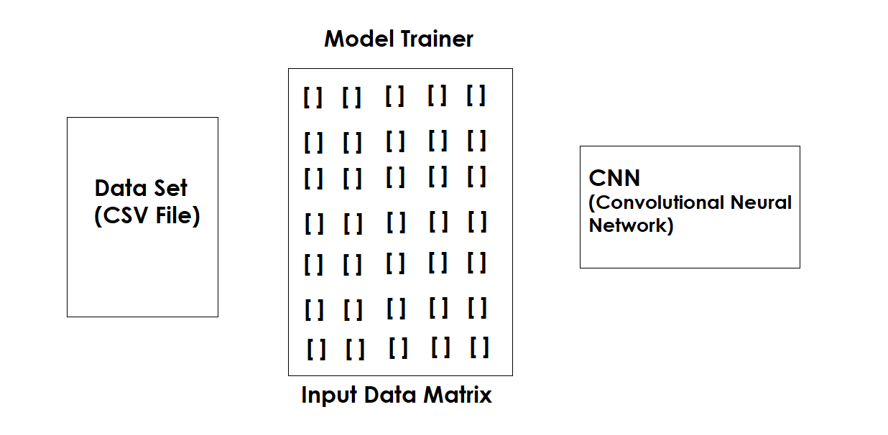
Model Trainer

Slide 8
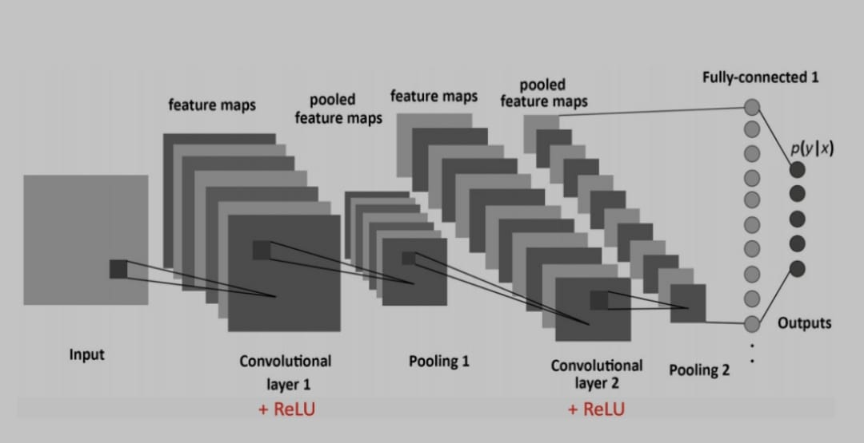
Model Trainer
CNN

Slide 9
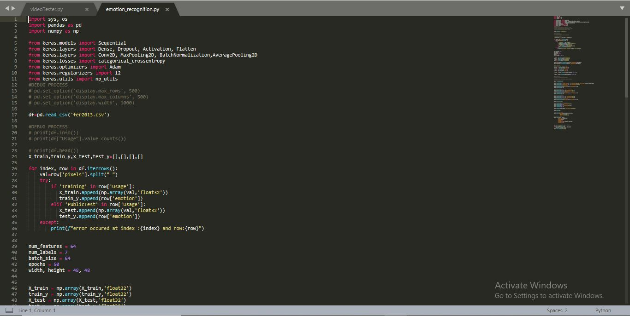
Model Training
Code Implementation

Slide 10
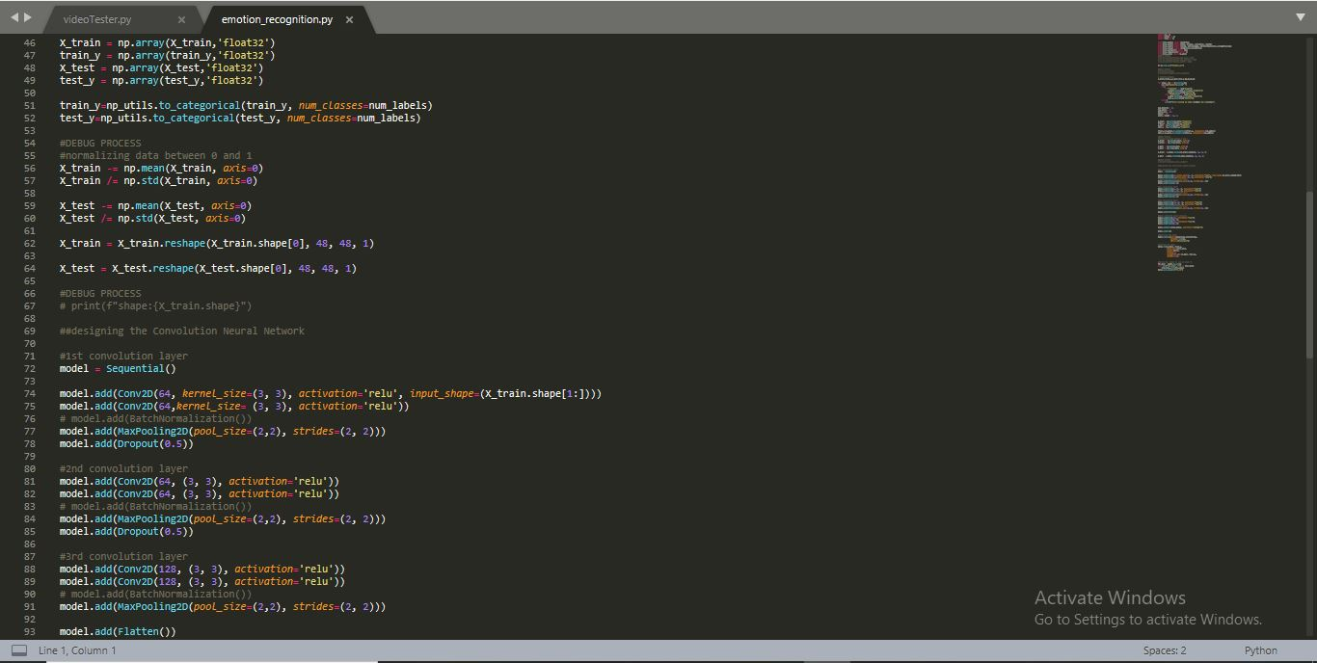
Model Training
Code Implementation

Slide 11
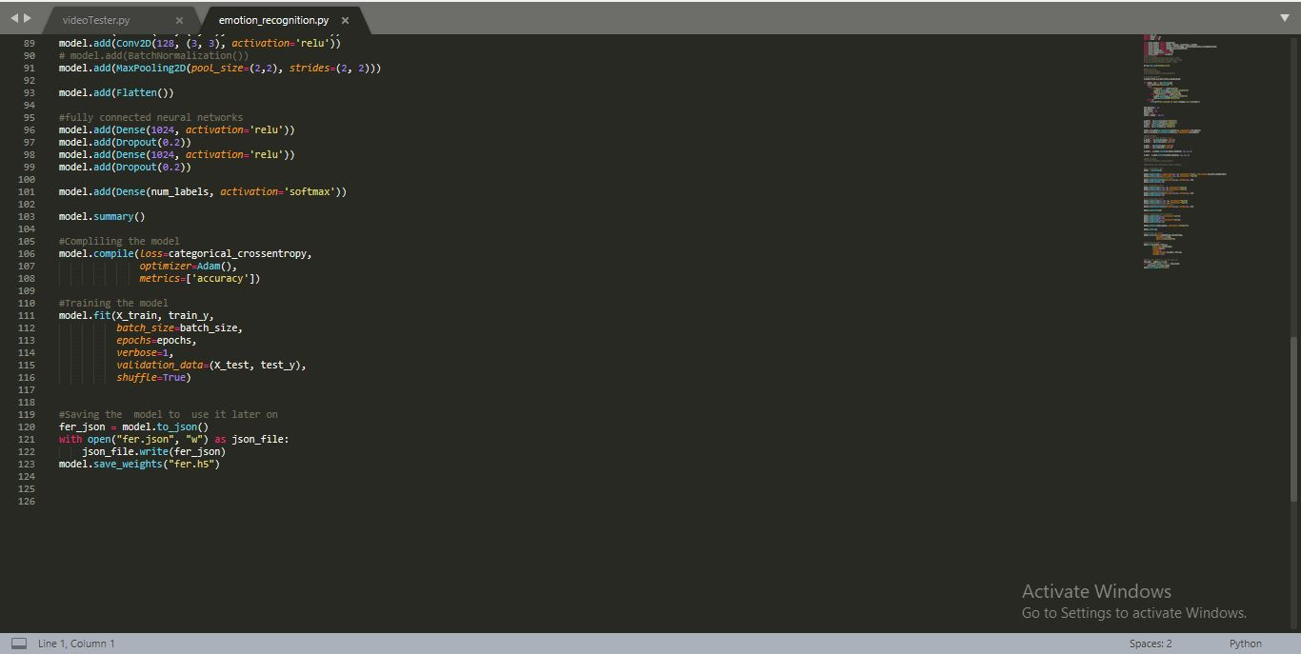
Model Training
Code Implementation

Slide 12
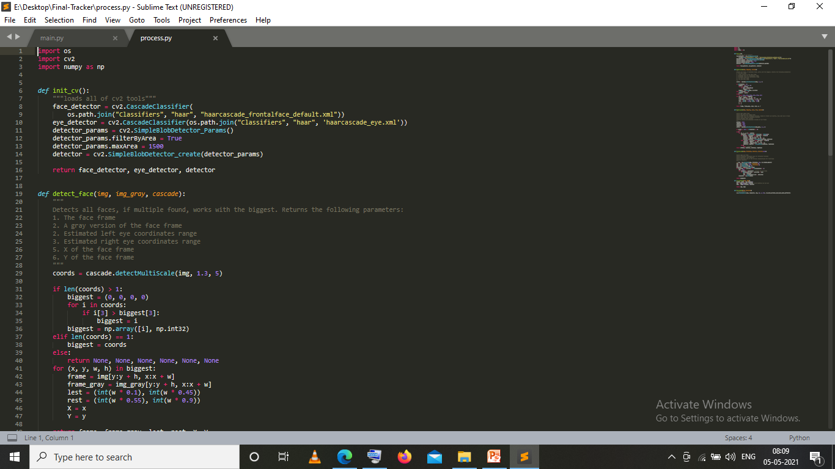
Code Implementation

Slide 13
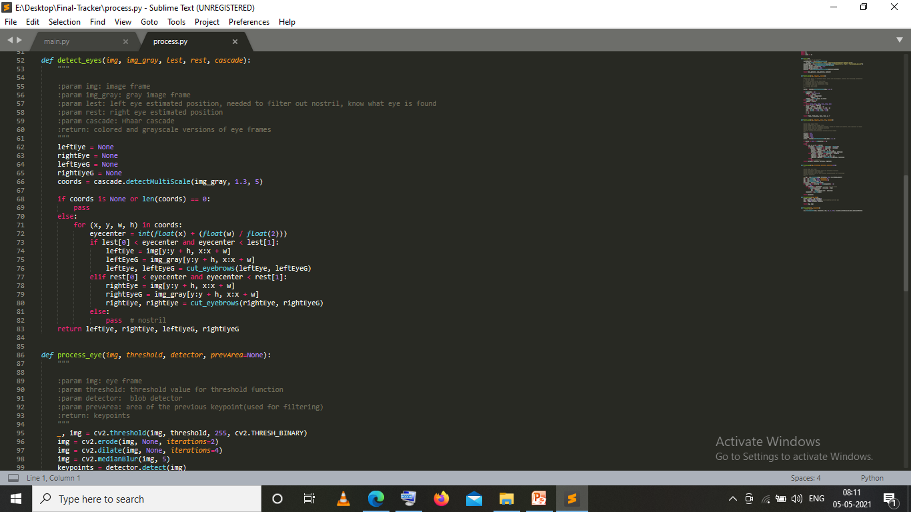
Code Implementation

Slide 14
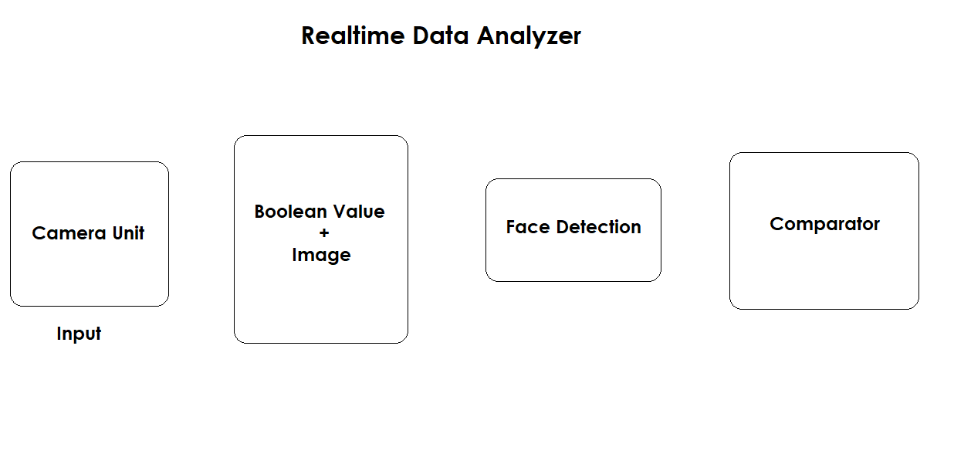
Realtime Expression Analyzer

Slide 15
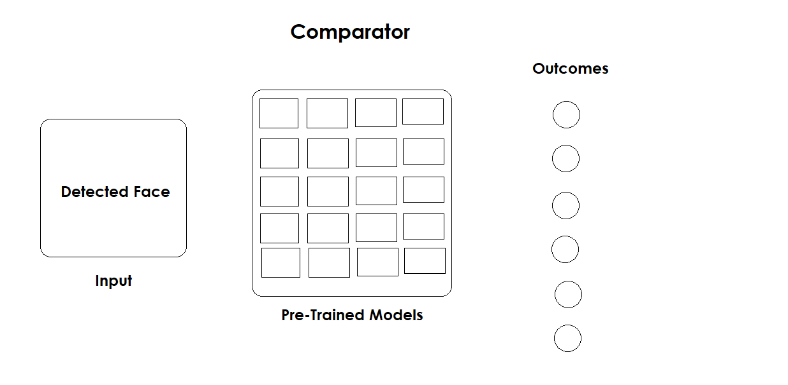
Realtime Expression Analyzer

Slide 16
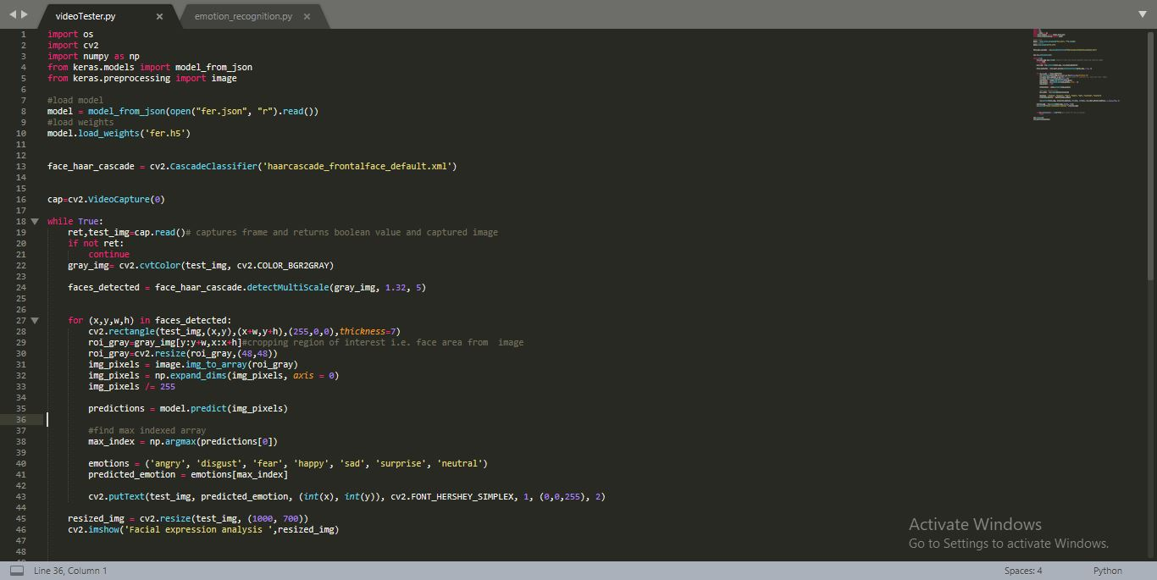
Realtime Expression Analyzer

Slide 17
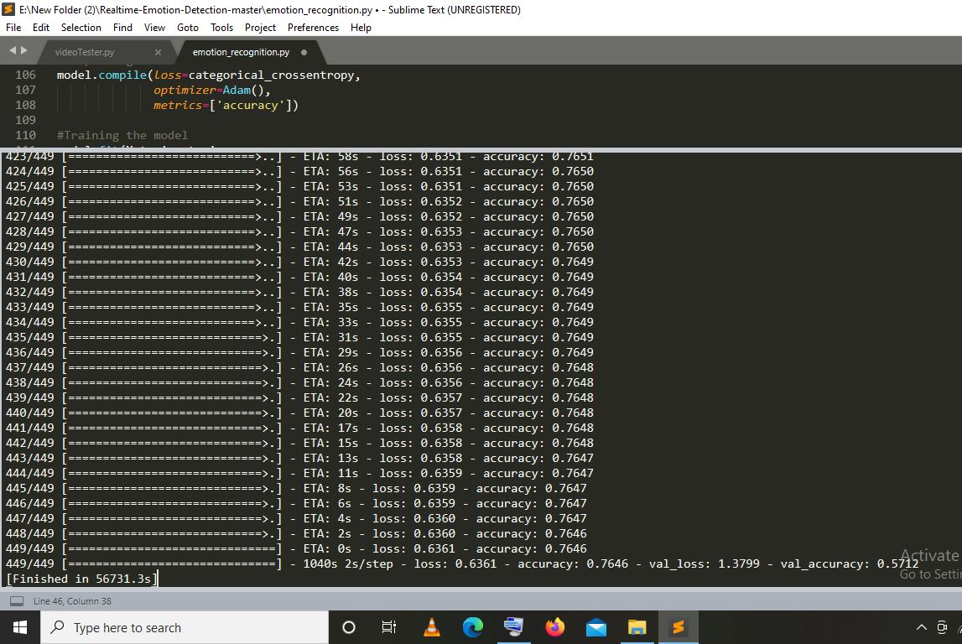
Accuracy Of Model

Slide 18
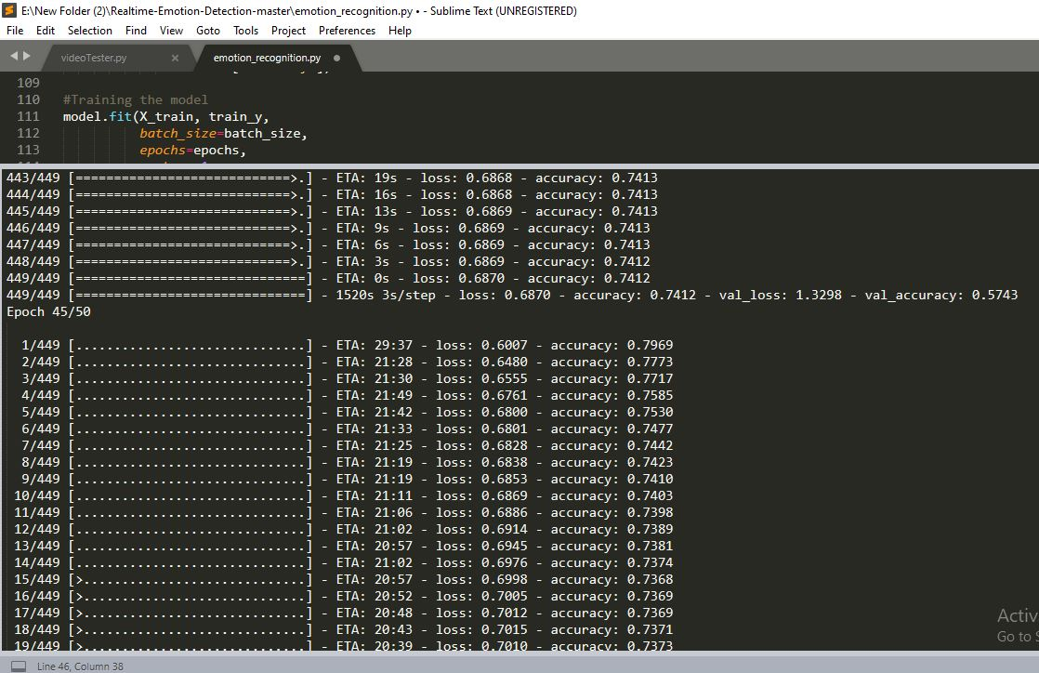
Accuracy Of Model

Slide 19
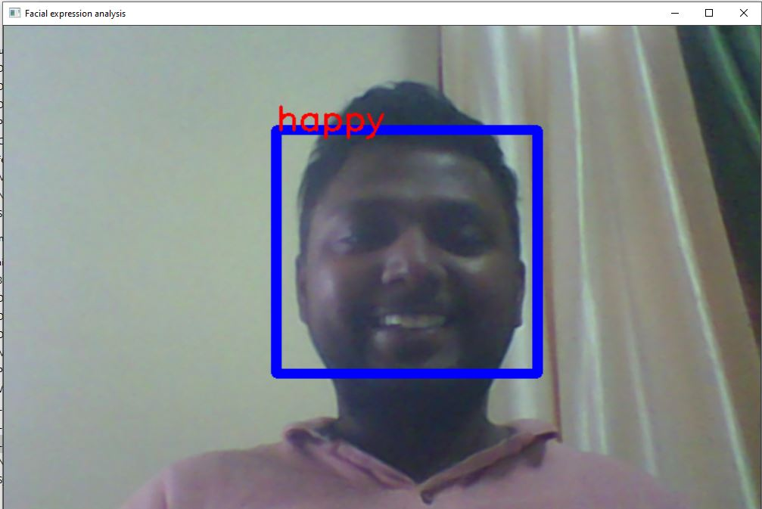
Outcomes

Slide 20
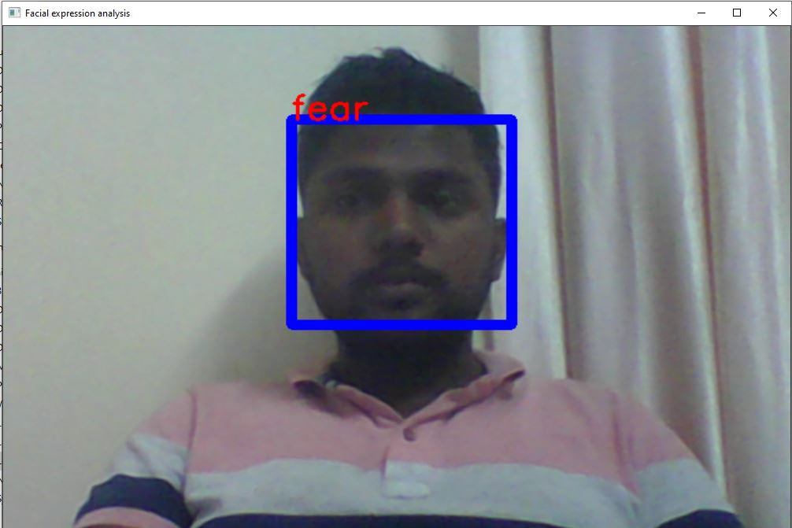
Outcomes

Slide 21
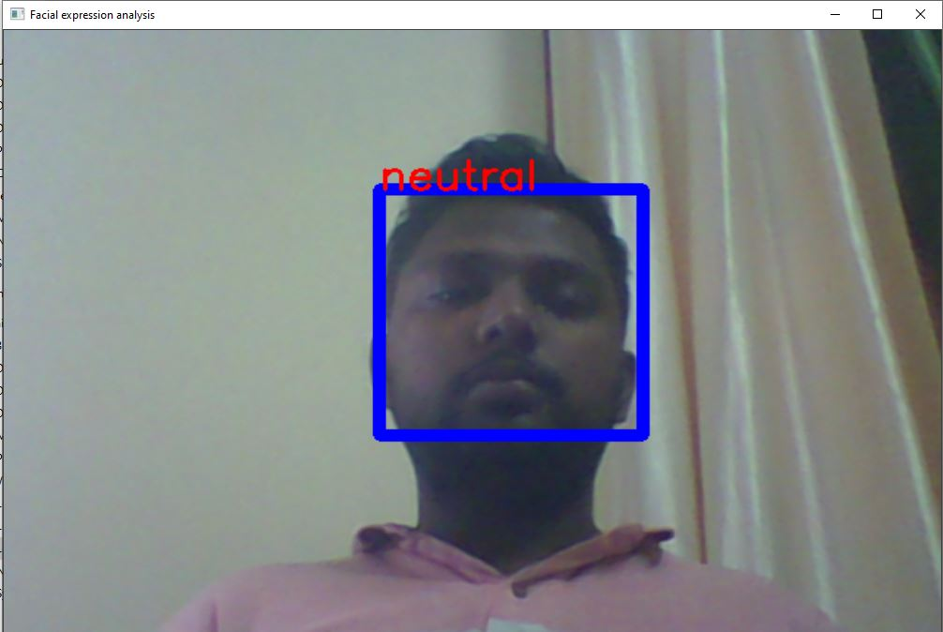
Outcomes

Slide 22
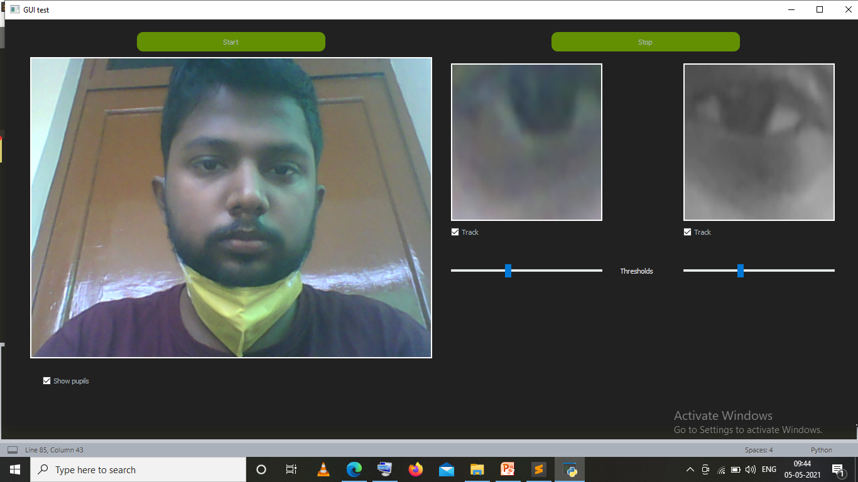
Outcomes

Slide 23

Thank you for your patience

